Slide 1
Damping influenced level attraction in CMP systems
Yutong Zhao
Sept 16th, 2019

Slide 2


















Objective
(a)
Transmission Line
$$κ_{1}$$
$$κ_{2}$$
$$γ_{1}$$
$$m$$
$$J$$
$$c$$
$$γ_{2}$$
$$κ_{L}$$
Loop sensor
$$γ_{2}$$
(b)
$$κ_{1}$$
$$Γ=\sqrt{κ_{1}κ_{2}}$$
$$γ_{1}$$
$$m$$
$$c$$
TL
$$κ_{2}$$
Additional damping channel
$$κ_{L}$$
$$J$$

Slide 3
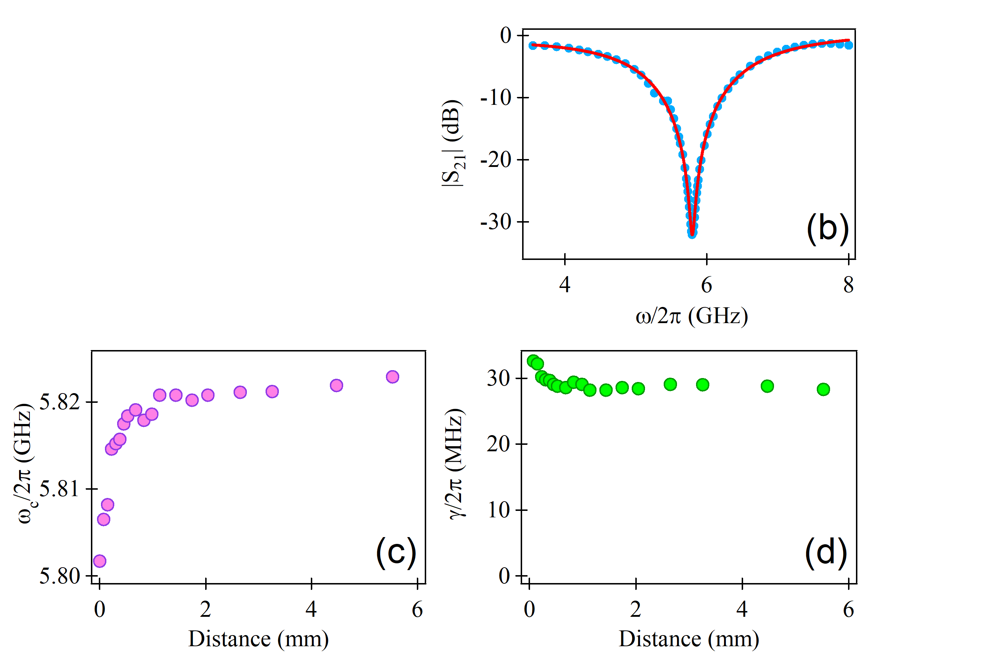
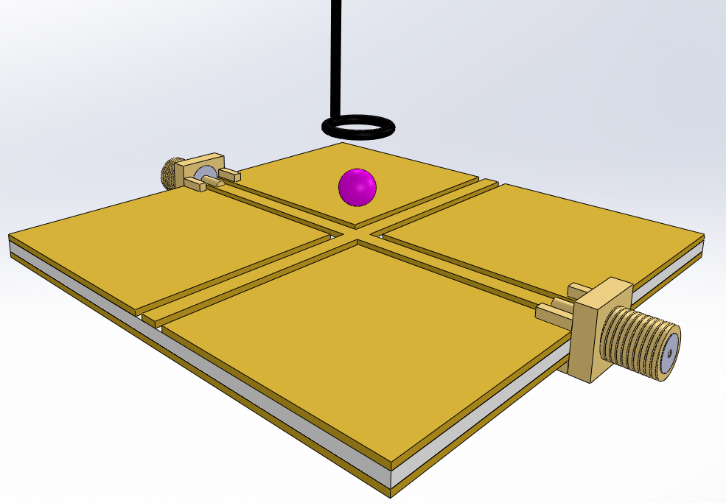


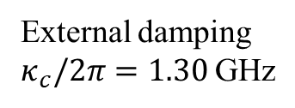

Characterize the bare cross cavity
Port 3
(a)
Port 1
$$D$$
CPW
cross cavity
Port 2
$\left(γ_{c}+κ_{L}^{c}\right)/2π$ (MHz)
External damping
$κ_{c}/2π=1.30$GHz
$κ_{L}^{c}$ Loop influenced cavity damping change

Slide 4
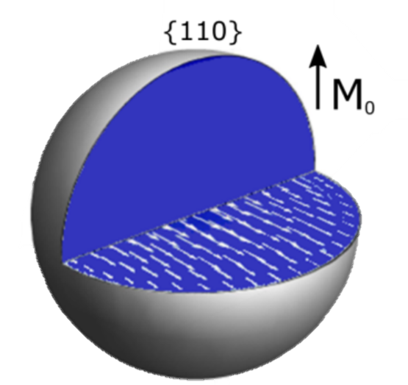
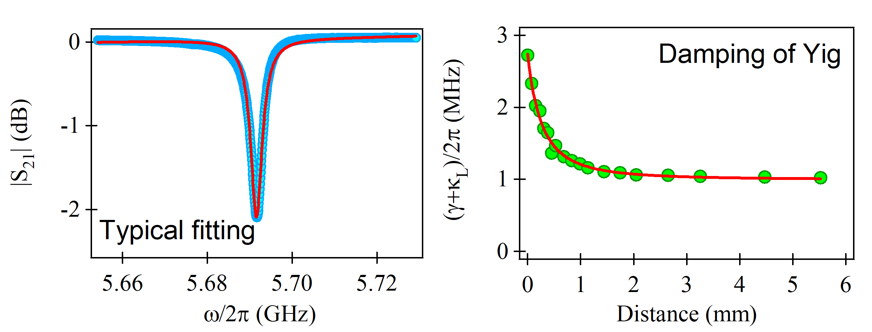


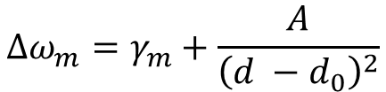

Characterize the YIG sphere
Intrinsic damping
– Gilbert Damping
External damping
– cooperative damping
– radiative damping
– other damping channels
$\left|S_{33}\right|$ (dB)
$\left(γ_{m}+κ_{L}^{m}\right)/2π$ (MHz)
(a)
(b)
$$Δω_{m}=γ_{m}+\frac{A}{{\left(d −d_{0}\right)}^{2}}$$
$$κ_{L}^{m}$$

Slide 5
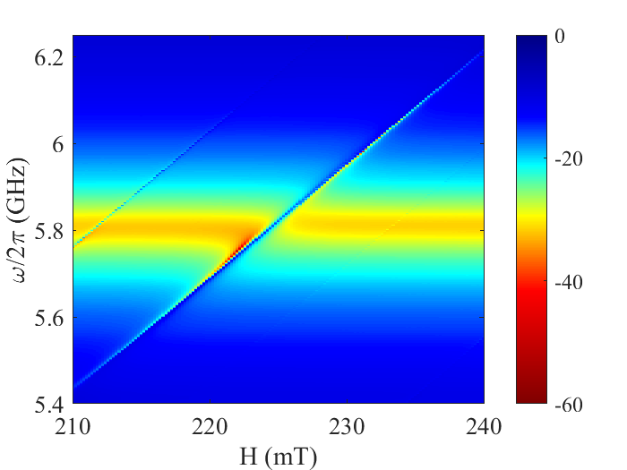
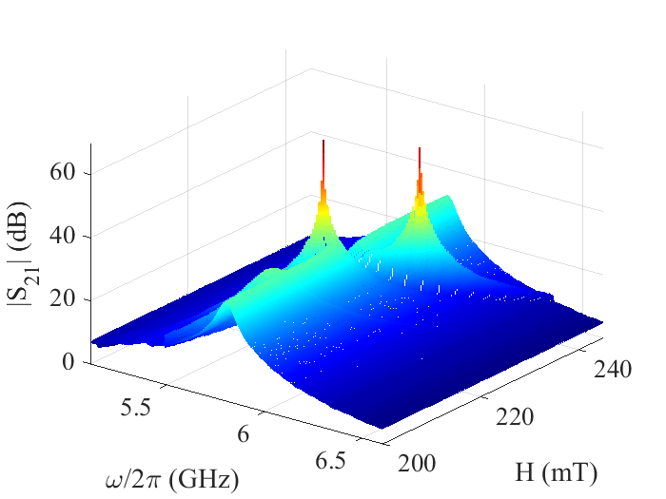
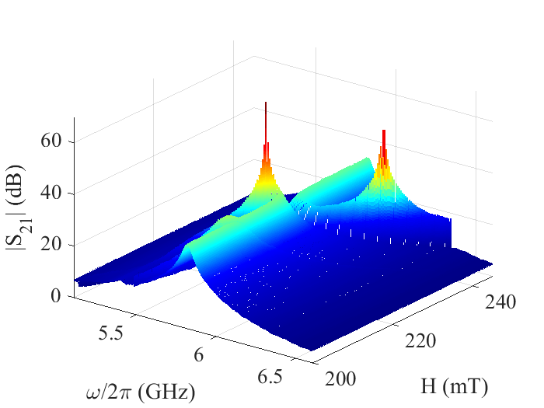
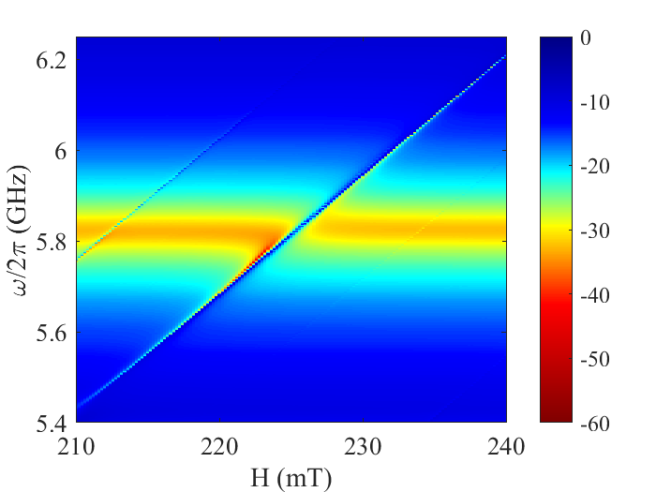


Level attraction measurements
S₂₁ mapping
S₂₁ waterfall
-
Center
Side
-
-
$$D≈ 0.05 mm$$
-
Center
Side
-
-
$$D≈ 5.6 mm$$

Slide 6
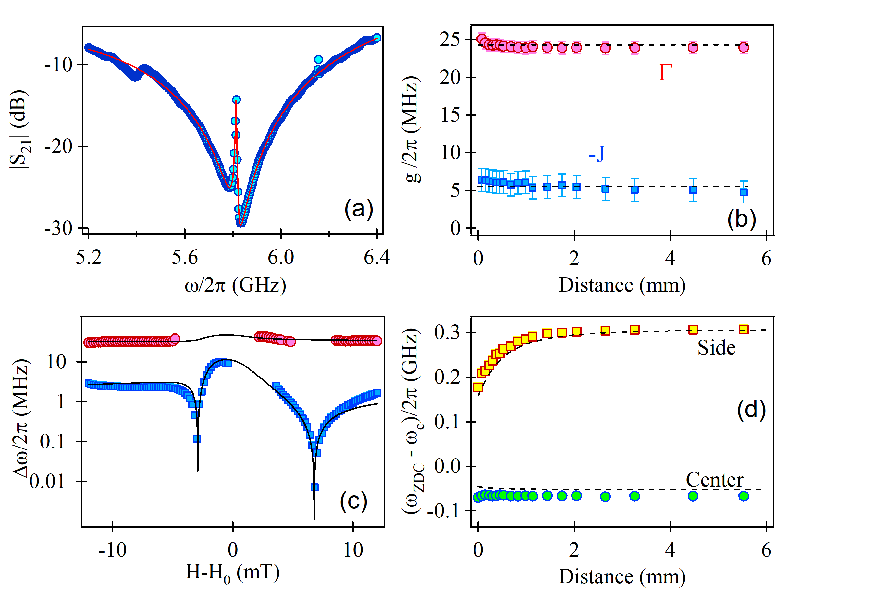
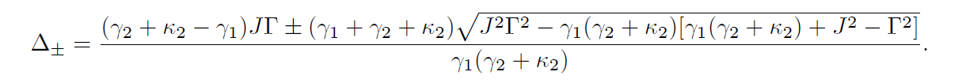
Level attraction data analysis

Slide 7
Conclusion
By using a loop sensor, an additional damping channel has been induced to the YIG sphere.
When changing the loop induced damping, the coupling strength remain the same while the ZDC has shifted a lot.
This study investigate the relation between the cooperative damping and dissipative coupling.

Slide 8


$κ_{c} ,κ_{m}$ - the external damping
$γ_{c} ,γ_{m}$ - the intrinsic damping
$κ_{c}^{L},κ_{m}^{L}$ - extra damping channel induced by loop sensor

